Slide 1

MIE-Summer 2024 Internship Final Presentation
Sai Teja Y

Slide 2

Background - me, me & Just me
Graduate Student from Purdue- Fort Wayne.
Bachelors in Information Technology from ANU, India.
Really into BCI - Brain Computer Interface.
Apart from academics I like photography, music.

Slide 3
Problem statement
Neural Network Patient Matching.
Training a Neural Network to assign a multi-dimensional vector for data like: name, address, visits etc.,
Need:
Patient Safety Risks*: 4% of duplicate records result in negative clinical outcomes, including treatment errors from missed or incorrect medical information.
Operational Inefficiencies*: Duplicate records and unnecessary tests due to matching errors lead to increased costs and care delays, affecting approximately 1 in 20 records.
* According to Pewtrust.org report

Slide 4

Internship Journey

Slide 5
Proposed Solution
Word Extraction
Generate syntactic
Data
Data Processing
Char2vec
Vector stacked

Slide 6

1. Data generation
We generated 100 unique patients records of:
Patient name
Phone Number
Address
Region/state
Appointment date

Slide 7
1. Data generation
Then we generate or replicated the 100 unique patient into 60k patient records and created random error into them

Slide 8
Loading the glove embedding of 50 dimensional.
We converted the names of patients into their respective glove embedding and stored them.
2. Glove Embeddings

Slide 9
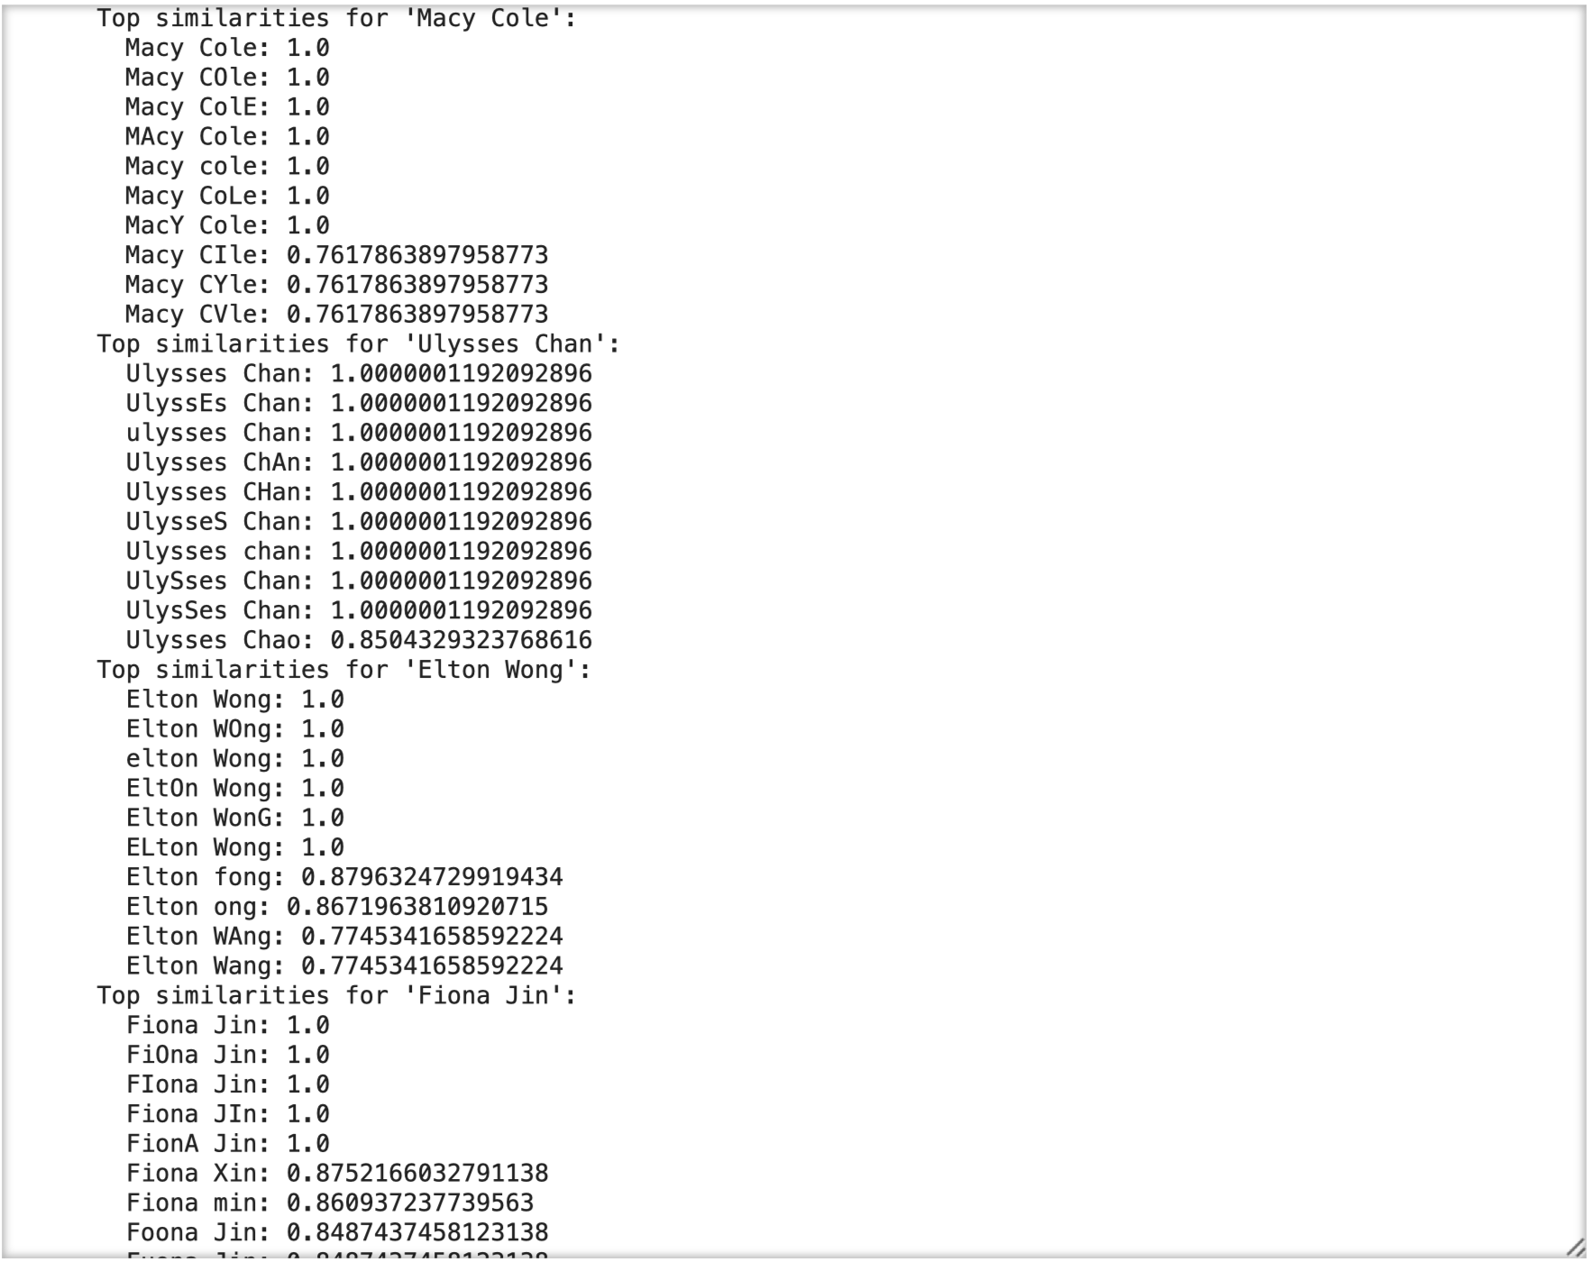
2. Glove Embeddings
Similarity Search
The Unique Patient name are then search among the patients records to find the top 10 similar name or close names and display the results.
Cosine Similarity is used for similarity search.

Slide 10
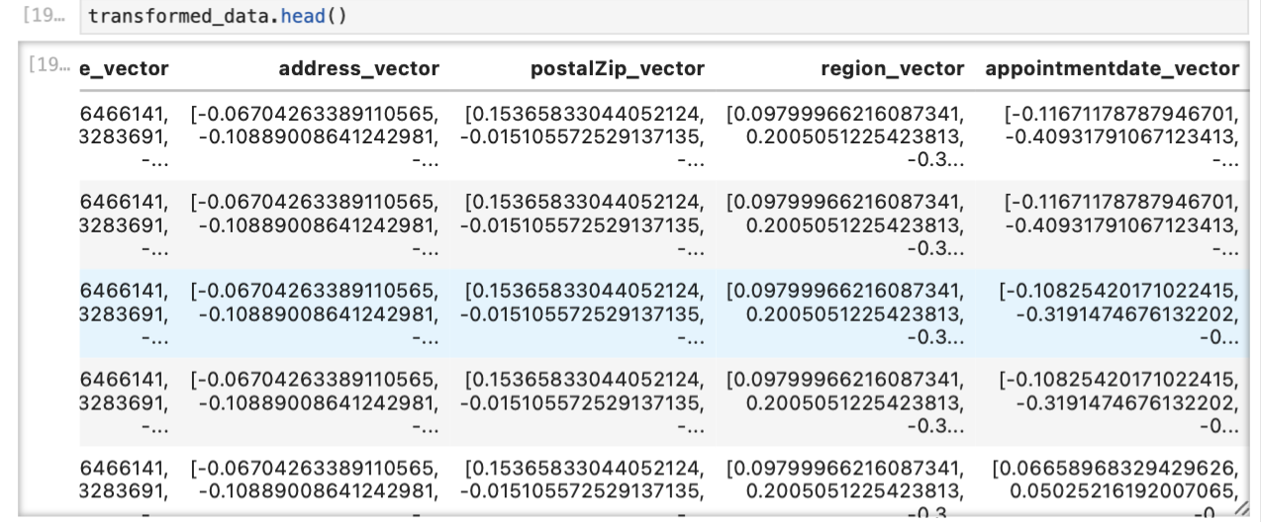
3. Chars2vec
Loading of chars2vec model.
Conversion of all the patients field to their respective vectors field.

Slide 11
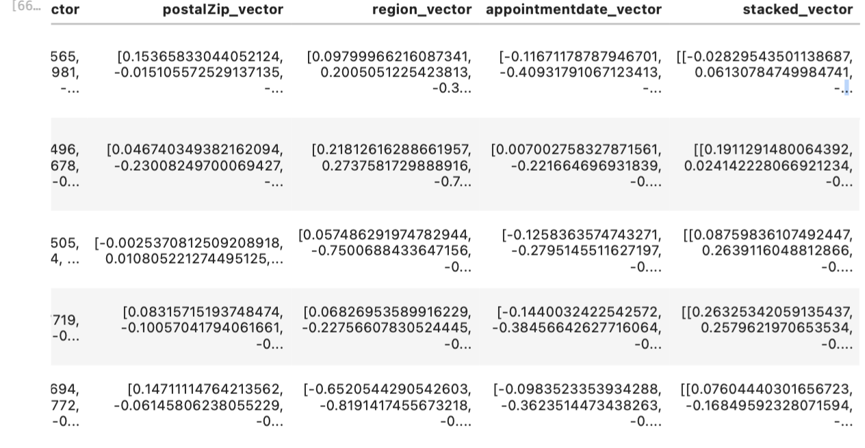
3. Chars2vec
Storing the vectors.
Stacking of vectors together to create a multi dimensional vectors of 50 dimensional each.

Slide 12
4. Similarity Search
Similarity search using cosine similarity and added threshold.
Finding the query name among vectors with:
Adjusting Threshold.
No.of Top Similar Names.
Performing Similarity search on vectors.
Similarity Search using Name.

Slide 13
4. Similarity Search
Similarity search on vectors using Faiss was conducted and Results were like Cosine similarity.
Thereby, concluding the similarity Search using Cosine similarity on Name using Threshold.
Similarity Test using FAISS

Slide 14
New Project Phone Number/Digit Analysis

Slide 15
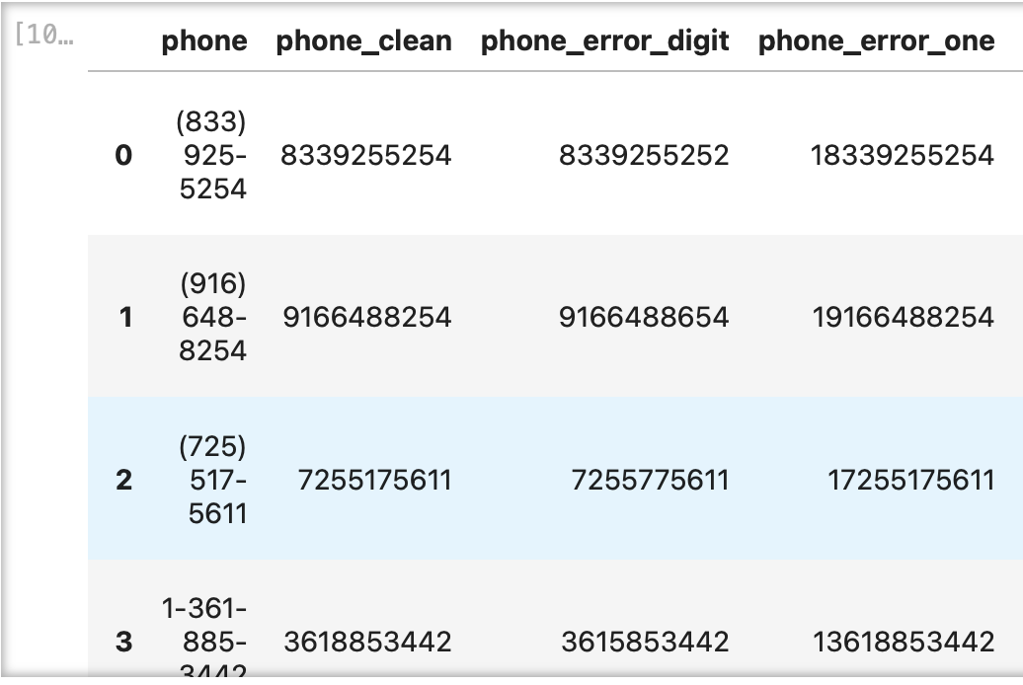
Part-1
Clean phone numbers by removing characters (-, 9, 0, +).
Alter one digit in the phone number.
Add '1' to the beginning of the phone number.
Convert the cleaned phone numbers to embeddings using chars2vec.
Compute cosine similarity between these embeddings and the clean number embeddings.
Calculate the Levenshtein distance between the embeddings.

Slide 16
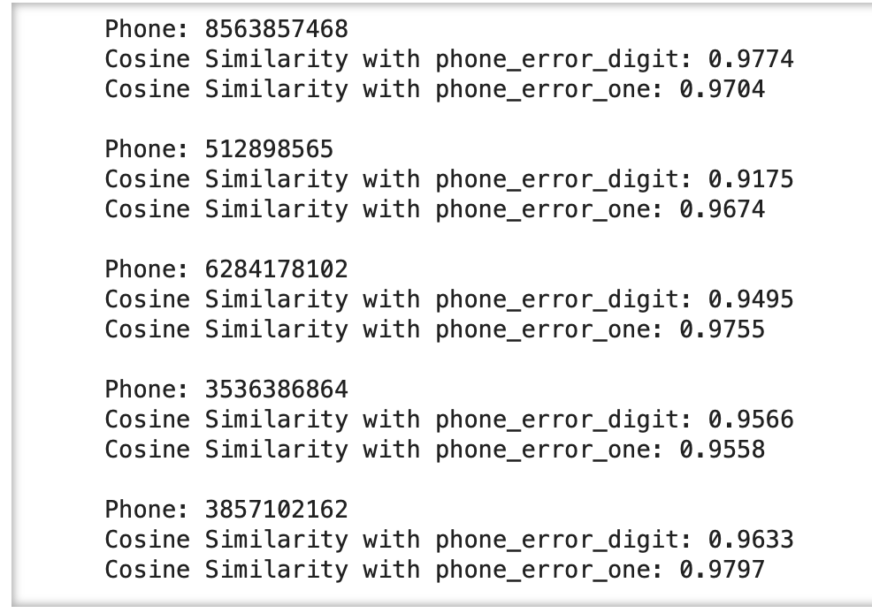
Part-1 Results
Most of phone numbers (Embeddings format) to that of clean and ‘+1’ numbers are 90% matching.
Average cosine similarity of clean number to error number is 71%
Average Cosine similarity of clean number to adding 1 digit is 70%.

Slide 17
Part-2
The main goal of the project is to explore and compare the accuracy of different methods for detecting similar phone numbers, particularly in the context of potential typographical errors. Two primary methods were selected for comparison: FAISS (Facebook AI Similarity Search) for vector-based distance calculation and Levenshtein distance for string-based similarity.

Slide 18
Part-2
Data Generation using Faker.js.
Cleaning the Phone Numbers.
Converting the phone Number to their respective natural embeddings.
Example: 99844562 to [9,9,8,4,4,5,6,2].
Using FAISS to find the query phone number and their closest number and calculate their similarity score and Distance as well.
Checked ideal threshold to include while searching the number.
Iterating through and finding the similarity and distance of each number in the limit threshold set.
Calculating the Levenshtein distance of each number to the top 10 numbers.

Slide 19
Part-2
Comparing the Faiss(Euclidean) and Levenshtein Distance of phone numbers.
Worked on phone number check using keypad proximity.
Checking the comparison using Faiss and Levenshtein Distance based on keypad proximity.
Conducting the test based on article on keypad proximity.

Slide 20
Part-2 Results
Type | Faiss Distance | Levenshtein Distance
Similar Phenetics | High | Low
Similar Appearance | High | High
Adjacent distance on keypad | Low | High(Based of digits shift)
Single Digit omit | High | Low
Repeat digit | Low- medium | Low
Reverse | High | Medium
Shift Digit | Medium- High | Low
Mirror | Medium- High | High
Duplicate Digit | Low | Low

Slide 21

Challenges & Outcome

Slide 22
Challenges & Outcome
Challenge 1: Glove embeddings, It got tough to understand the glove embedding and one point I have search the name in glove embedding instead of generating the name embedding using glove.
Challenge 2: Embedding those name took longer time, and I must change the code couple of time.
Challenge 3: Chars2vec took long to convert the records to embedding, Parallel programming using Chunks to sort the issue.

Slide 23
Challenges & Outcome
Challenge 4: Stacking Vectors, those vectors on converting to .csv changing to strings and getting issue while extracting into data frame.
Challenge 5: Testing the similarity search using the query name and search the stacked vectors using cosine similarity using thresholds and Faiss using threshold, Dimensionality Reduction as well.
Challenge 6: Dockers issue with script on permission to save the notebook- Change the user to root to copy the files needed and in user updated save the notebook permission. H5py issue and had to update the script to install development libraries (libhdf5-dev) and compilers (gcc, g++).

Slide 24
Challenges & Outcome
Outcomes:
Learned Glove Embedding.
Learned Chars2vec.
Learned Dockers.
Perform Similarity Search.
Learned FAISS.
Generation of Synthetic Data.
Work on Digits.
Convert the text to Vectors.
Vector Indexing and VectorDB.

Slide 25
Technologies
1. Git - A distributed version control system that tracks changes in source code during software development.
2. Python - A high-level, versatile programming language known for its readability and extensive libraries.
3. Jupyter Notebook - An interactive development environment that allows you to create and share documents with live code, visualizations, and narrative text.
4. Faker - A Python library used for generating fake data such as names, addresses, and dates, useful for testing and development.
5. Nameparser - A Python library that parses human names into their individual components like first name, last name, and titles.
6 .GloVe - (Global Vectors for Word Representation) A word embedding technique that generates dense vector representations of words by analyzing word co-occurrence statistics.
7. Char2Vec - A neural network model that creates vector representations for characters, capturing their context and relationships within text.
8. Faiss - A library developed by Facebook AI for efficient similarity search and clustering of dense vectors.
9. Cosine Similarity - A measure of similarity between two non-zero vectors that calculates the cosine of the angle between them.
10. Vector DB - A database designed to store, index, and query vector data, often used for similarity search tasks involving embeddings or vector representations.
11. Faker.js - A JavaScript library that generates fake data for various types of fields, useful for testing and development.
12. Docker - A platform that enables developers to automate the deployment and management of applications within lightweight, portable containers.

Slide 26

THE END

